Slide 1
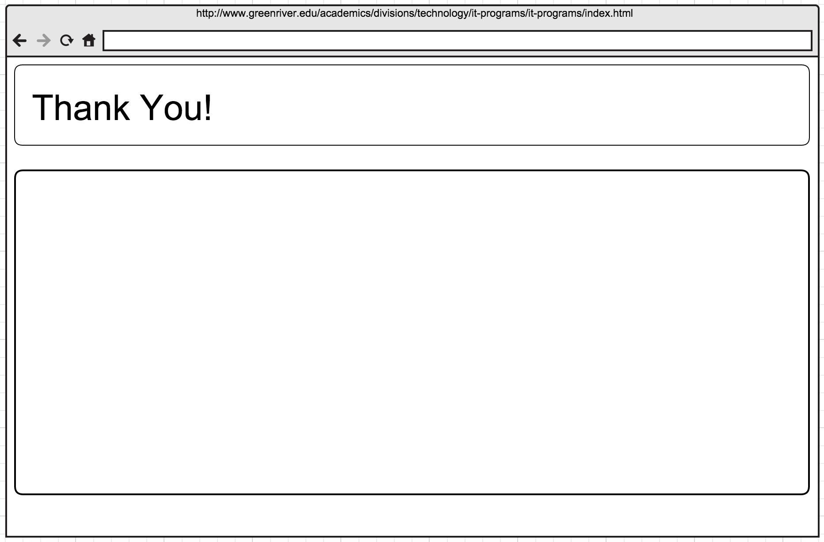
Your application has been submitted. We will contact you in 48 hours with a reminder to complete enrollment for <Program name goes here>.

